Slide 1

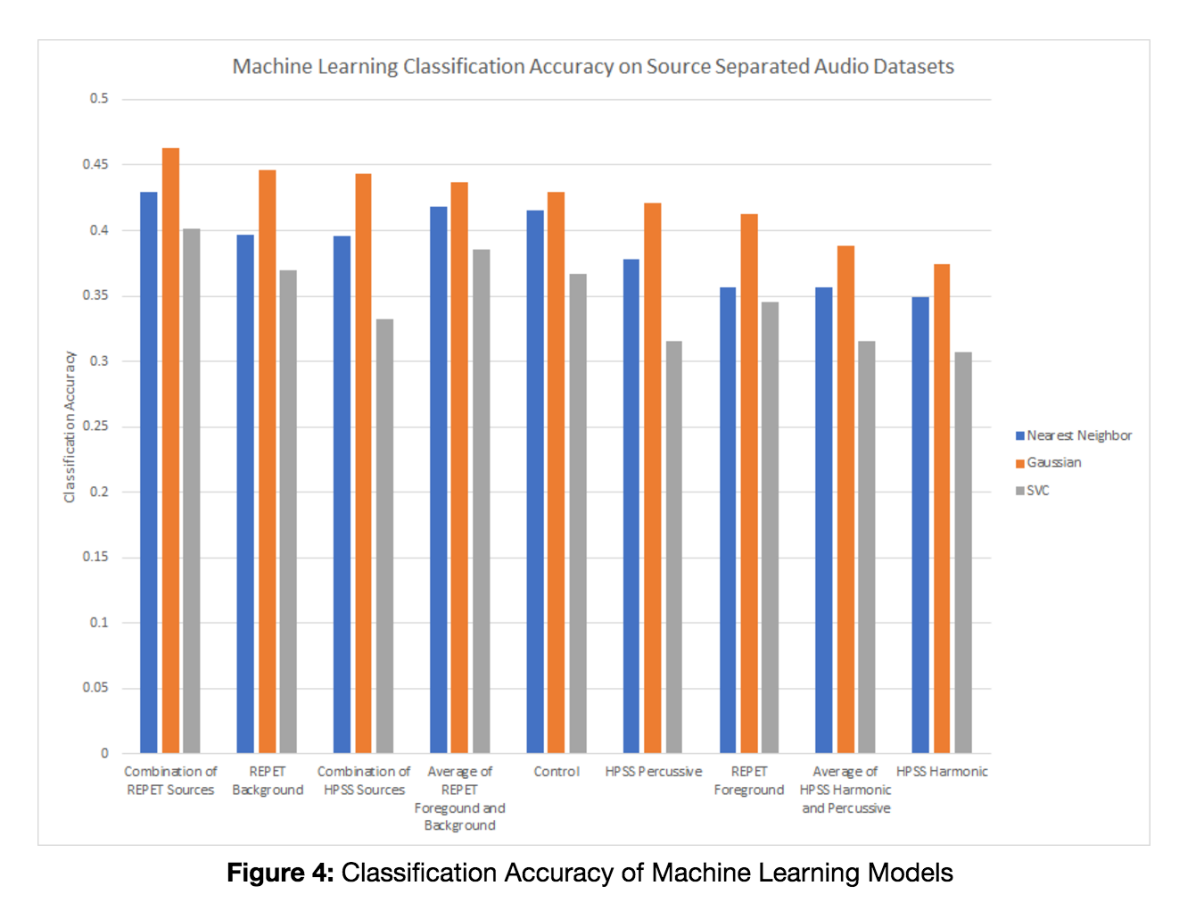
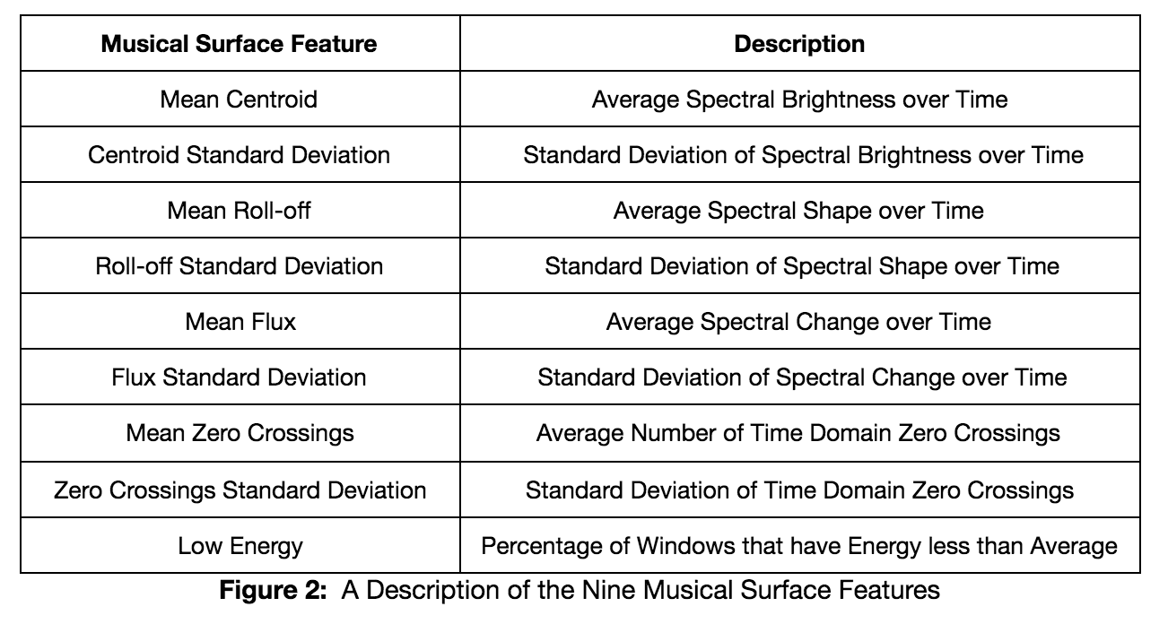
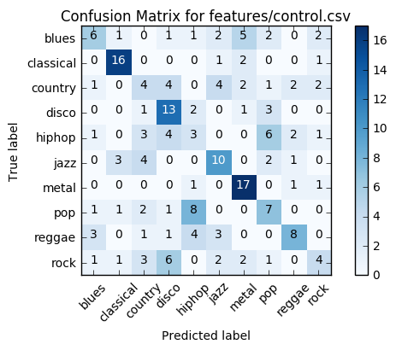
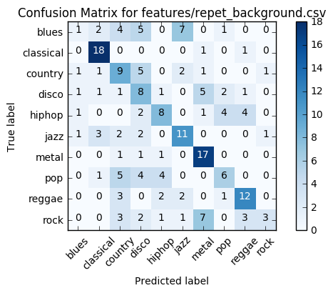
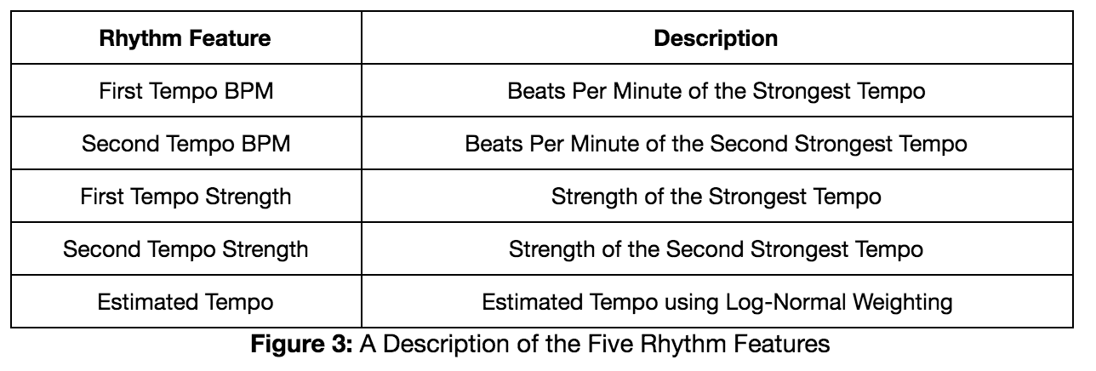

POSTER TITLE
Author List
Department of Biomedical Engineering, Northwestern University, Evanston, IL, USA
The Effects of Source Separation on Genre Classification
Daniel Perlovsky, Daniel Thomas and Oliver Goodman
EECS 352, Winter 2017, Instructor Bryan Pardo
Biomedical Engineering
Abstract
Feature Extraction
Results
This project aims to answer the question: do source separation techniques aid in genre classification? Past studies have examined the effects of genre classification using harmonic-percussive source separation. This project reexamines this approach with more modernized source separation algorithms: Librosa’s harmonic-percussive source separation and REpeating Pattern Extraction Technique (REPET). Both surface and rhythmic features were extracted from each separation and compared the results over three types of models: nearest-neighbor, Gaussian Naive Bayes, and a support vector classification. The performance of each of these models has been evaluated based on examining the accuracy of their predictions and their respective confusion matrices, ultimately examining which source separation is more effective in genre classification.
Used GTZAN Genre Classification dataset
1000 audio files, each 30 seconds
Ran HPSS and REPET to get five source variations
Had 14 dimensional surface vector
Broken up into surface and rhythm features
Created 9 datasets to run models on
Control (Original Audio Files)
REPET Background
REPET Foreground
HPSS Percussive
HPSS Harmonic
REPET Averaged
REPET Combined
HPSS Averaged
HPSS Combined
Introduction
Project Goals
Compare different genre classification models
See if source separation improves classification
Compare HPSS to REPET
Classification
Conclusions
REPET Background and Combo marginally more accurate
HPSS is not more accurate
Classical and metal easier to classify
Source Separation does not have a positive effect on genre classification
Used 3 Models
Gaussian Naïve-Bayes
K-Nearest Neighbor
Support Vector Classifier
Training: 80% Testing: 20%
Ran each model on each dataset 100 times
References
[1] G.A. Tzanetakis, G. Essel, P. Cook, Automatic Musical Genre Classification Of Audio Signals
[2] G.A. Tzanetakis, P. Cook, Musical Genre Classification of Audio Signals
[3] P.S. Lampropoulou, A.S. Lampropoulos and G.A. Tsihrintzis, Musical Genre Classification of Audio Data Using Source Separation Techniques
[4] C. Mckay, I. Fujinaga, Automatic Genre Classification Using Large High-Level Musical Feature Sets
[5] Z Rafii, B. Pardo, REpeating Pattern Extraction Technique (REPET): A Simple Method for Music/Voice Separation
[6] B. McFee, C. Raffel, D Liang, D.P.W. Ellis, M. McVicar , E. Battenberg, O. Nietok, Librosa: Audio and Music Signal Analysis in Python
[7] H. Tachibana, N. Ono, H. Kameoka, S. Sagayama, Harmonic/Percussive Sound Separation Based on Anisotropic Smoothness of Spectrograms

